Slide 1
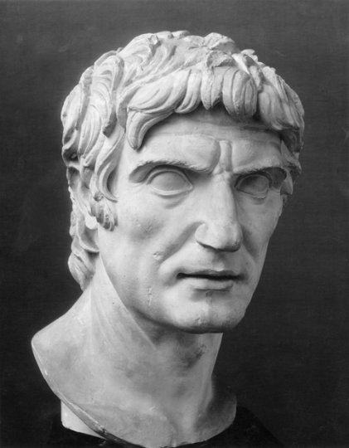
Pontus and Mithridates
GOAL/S: Describe the rise of Pontus’ Kingdom under Mithridates VI and it’s threat to Rome
Week 1, Lesson 2

Slide 2
Where is ‘Pontus’?
Pontus was a Hellenistic kingdom centred in the historical region of Pontus in modern-day Turkey, and ruled by the Mithridatic dynasty of Persian origin, which possibly may have been directly related to Darius the Great of the Achaemenid dynasty.
Notes:
Anatolia or Asia Minor in the Greco-Roman period: The classical regions, including Pontus, and their main settlements.
s a large peninsula or a region in Turkey, constituting most of its contemporary territory. Geographically, the Anatolian region is bounded by the Mediterranean Sea to the south, the Aegean Sea to the west, the Turkish Straits to the north-west, and the Black Sea to the north.

Slide 3
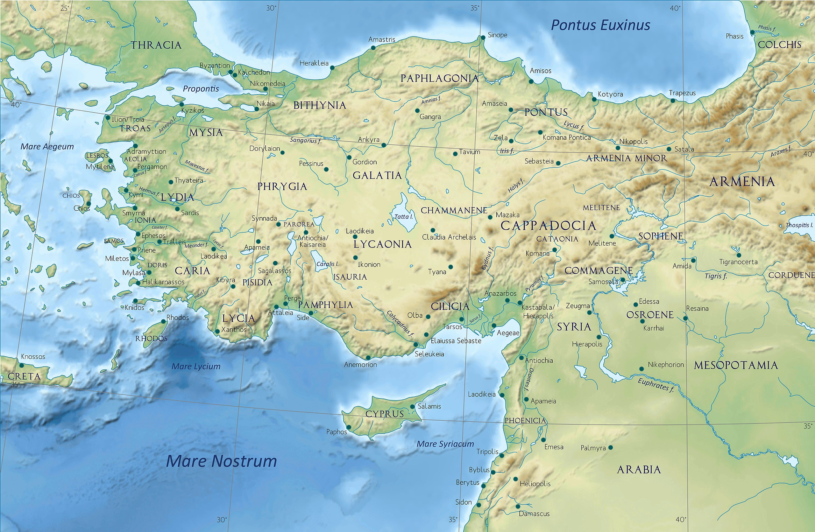

Slide 4
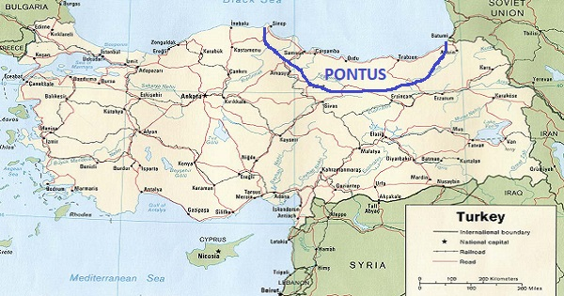

Slide 5
Who is ‘Mithridates’?
Mithridates or Mithradates VI (6) Eupator
135 – 63 BCE
The ruler of the Kingdom of Pontus in n. Anatolia (120 to 63 BCE)
One of the Roman Republic’s most formidable and determined opponents
Effective, ambitious and ruthless ruler
Sought to dominate Asia Minor and Black Sea region
Waged several hard-fought but ultimately unsuccessful wars to break Roman dominion over Asia and the Hellenic World
He has been called the greatest ruler of the Kingdom of Pontus
After his death, he became known as Mithridates the Great.

Slide 6
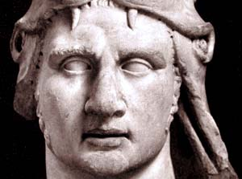
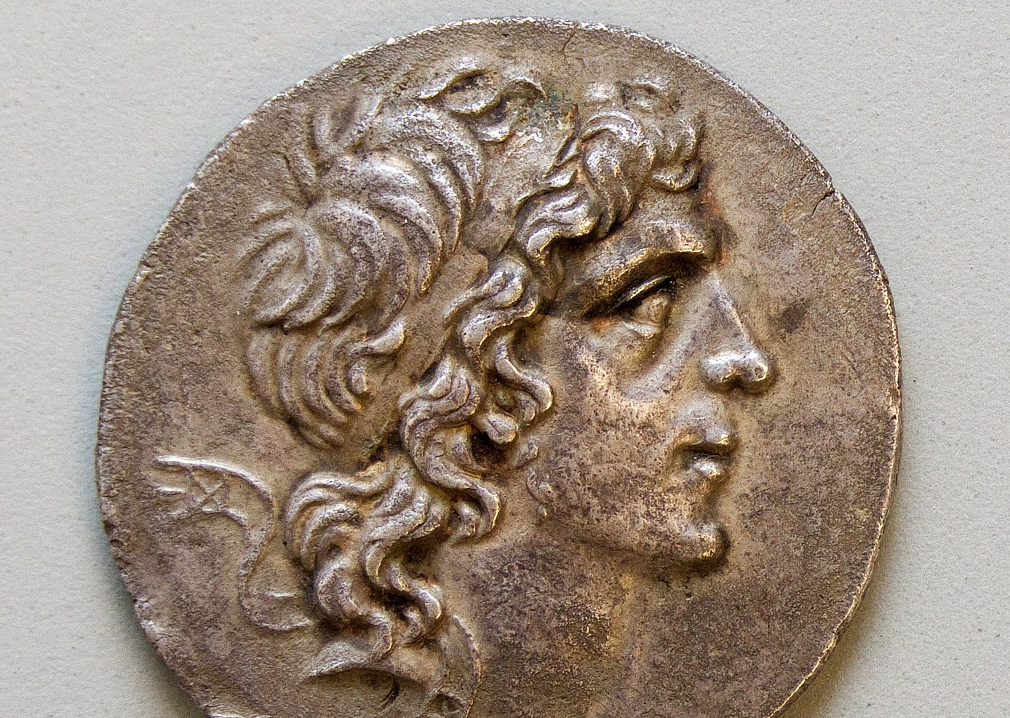
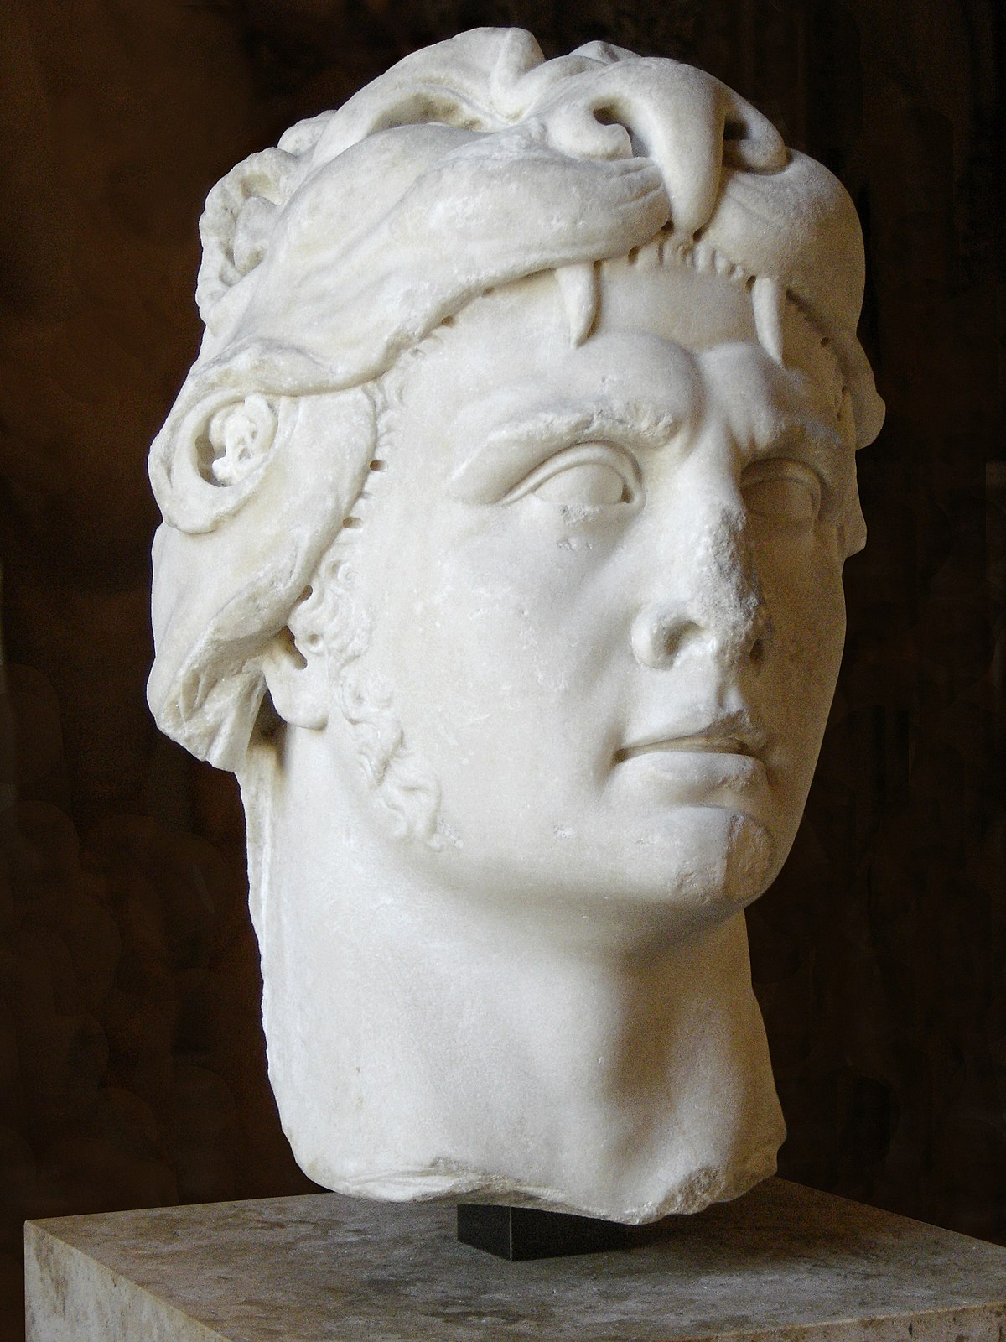
FUN FACT!
Mithridates cultivated an immunity to poisons by regularly ingesting sub-lethal doses; this practice, now called mithridatism, is named after him.

Slide 7
While the Roman republic had been preoccupied with its wars in Africa, northern Italy and the Social War, the kingdom of Pontus had been expanding out its own empire in Asia Minor. Its young king, Mithridates VI, had ambitions of forging a kingdom that would incorporate the best elements of the old Greek and Persian empires. Mithridates won a series of surprise victories against Roman forces in Asia Minor. He had even managed to seize parts of mainland Greece. When Rome had recovered from the brutal Social War, the Senate finally realised that Mithridates VI was a significant threat. It was decided that he needed to be dealt with immediately.
Notes:
The Rise of Pontus

Slide 8
Sulla’s First March on Rome
KEY EVENT

Slide 9
This was a monumental moment in the history of ancient Rome, as it was the first time that a Roman general had led a Roman army against their capital city. Sulla's first march on Rome was also a significant event because it broke the tradition of not bringing an army into the city, setting a dangerous precedent for future Roman generals.
Why is this a significant event?

Slide 10
ACTIVITY – The First March on Rome
We are briefly going to learn about Sulla’s First ‘March On Rome’.
“Marching on" a location can signify the movement of troops or armed forces towards a city, region, or strategic position to engage in battle, seize control, or effect political change.
Each of you will be provided with a Comic Strip.
Under each box, is a description of an event/people/ideas that provide historical context to Sulla’s First March on Rome.
Read through each box. Draw an image to represent each event. MAKE SURE YOU CAN TELL THE STORY!
When complete, cut and paste into your book – colour in if you have free time.

Slide 11
This was a significant development in the use of the word hostes in Roman history. Up to that point, it had only been used to describe Roman's military enemies: usually foreigners. By using this word to describe fellow Romans, Sulla introduced the idea that war could be waged upon them in the same way as their traditional enemies on the battlefield. Once Sulla was confident that Rome was safe from Marius, he finally departed from Italy in 87 BCE with his army for Asia Minor and for the war against Mithridates

Slide 12
EXTRA TIME
https://www.youtube.com/watch?v=Tz3X_u5Mzi0&ab_channel=Invicta
https://www.youtube.com/watch?v=zVfTDi7AuF4&ab_channel=Jabzy

